Slide 1
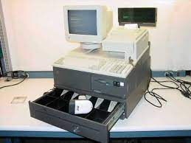

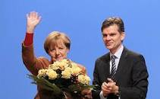
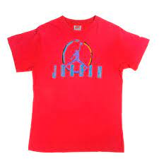
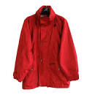
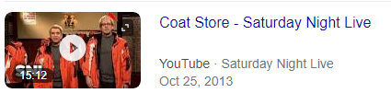
FBI
partner
development
ATOMICLOCI(ghoe(Tyson.int)
”Groceries”
2000 CHECKPONT CHARLIE(IBM Cash Register, KdWe)
Sin,§Theft
2000 RED Shoeffel
1995 RED 41.§Theft Gorbache(Jodan T-shirt)
.”Groceries”
WW2.WAR.”Groceries”
MOTIVE: Gorbachev(Tyson, apptice long blond hair 190lbs )
TORT-II.AUSCHWITZ
VP GERMANY.Geukes.Tyson
Snl.PENTAGON.VIRTINA.MARY.sin

Slide 2

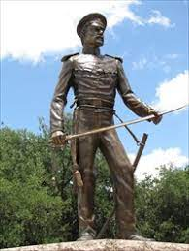
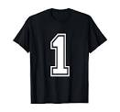
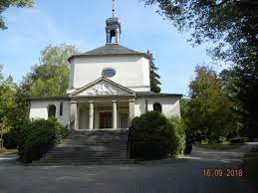
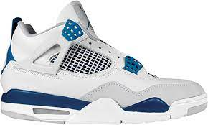
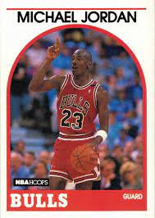
FBI
partner
development
Overlays
Violations Payable ot runnable city to remove. Int.avg
Pivotal(SF) glu
2019 §DEA(possession) guy in back smoiing
Texas Runners (iditors), foort jersracs
1 Football jeersey
41.prof.marx
2022
Dragoos
18?? CIVIL WAR(BEFORE)
§Stalking , AggAssalt 5:00pm
Police Sirents; 5:04PM
Police Sirens: 5:06
2022
1986/7
1988/9

Slide 3
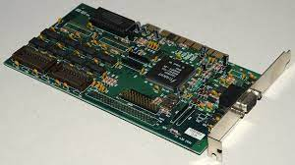
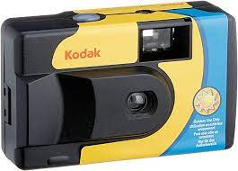
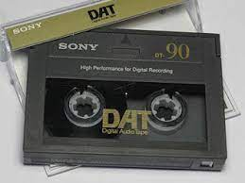
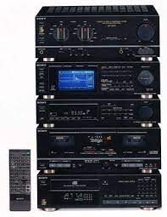

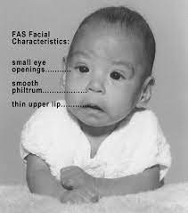
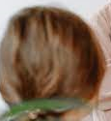
FBI
partner
development
2000
WAR
WWI.MAINSTREET.MARKET.CPVA.flea. COMPUTER DEPARTENT
Kriegstrasse
Police Sirens: 5:16PM
!FBI.recoder.WAR(kriestrasse) HOCME:IS-A-BELL.nonPoicQOS.tape material
IPX 1992 Dietzenbach CPVA.J5
Sony player
child with drunk parent syndrome
j5
1991

Slide 4
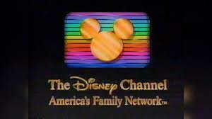

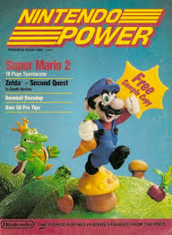


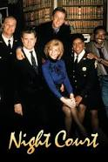


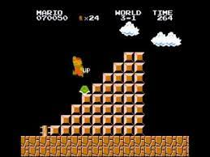




FBI
partner
development
3-1
1988/9

Slide 5
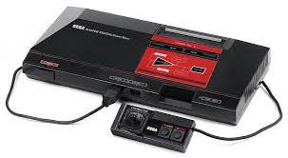
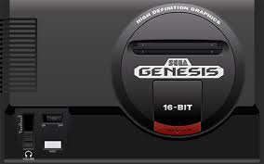
FBI
partner
development
1986/7
3-1
1988/9

Slide 6
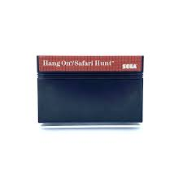


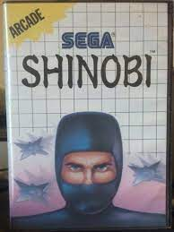
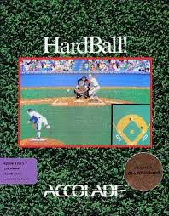
FBI
partner
development
1986/7
Hudson Court

Slide 7

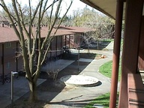

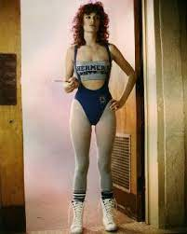
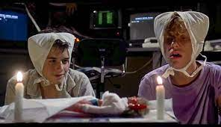
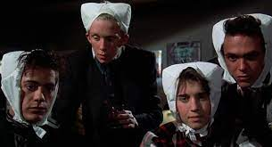
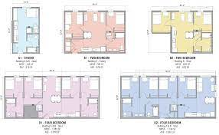
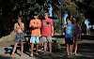


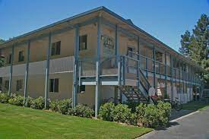
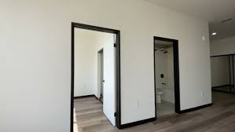
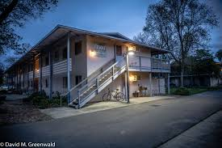
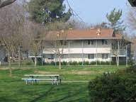
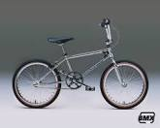
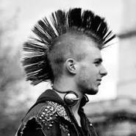
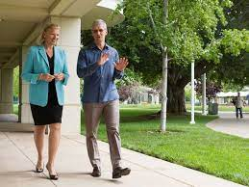
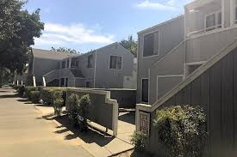
FBI
partner
development
1988/9
41.§Stalking.SQ.
Polci Sirents: 6:27
Roth.ibmdamiler.Apple.davidon.marx.hellsangles docs
Soa.davis.sacrameto
J-10
Bradon
Tyson
Jason
Malcom
Mathew
Mother: go to the bathroom if you have to fart
Origian: prea.naked joe,condoms
roth
Kichen, children room
Couh and tv
Goldman Sax
41. RUSSEL 500
HOMCIE:KYSTAL
Russel Park
§Theft BMX
ATOMCLOCI(amy,Jamie)
Jamie/ibm.jamei.VIRGINAI
41.St. Nick.IPX.HOCMEL:LUX:HATHOLE:moped
Stands there iwht stolen bicycyel spray paninted
41
CPVA.PREA.§187
“Pricipals office”.INT FOSTER CITY(BMX)
FRAMKFURT(cocain,levis, HOCIEM:AUSLAERN.IPX)
We are not hallloweeners

Slide 8
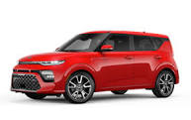


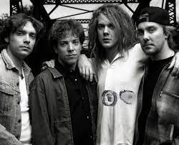


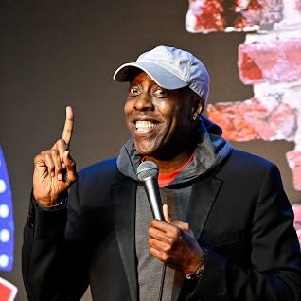
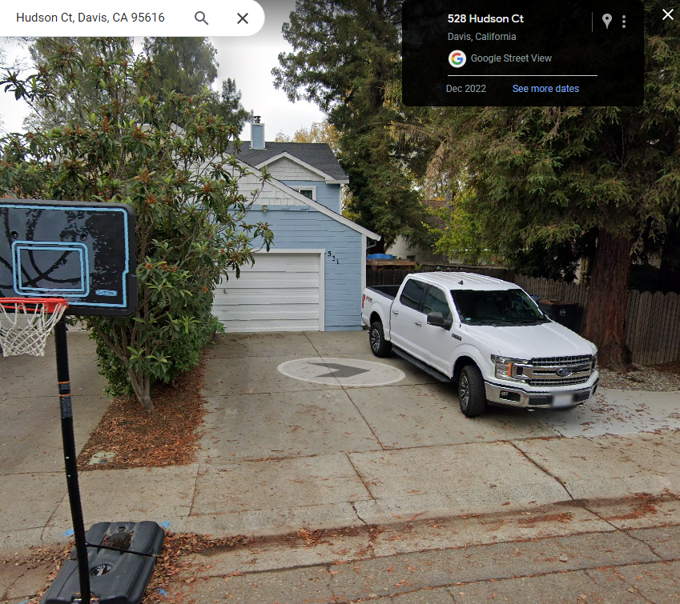
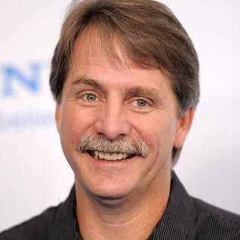
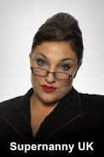
FBI
partner
development
1990/1
ATOMICLCOK
Hudson Court
VIRIGNIA
Borgoff/Mark
CPVA.PREA
IMPORT Stefan/Cargill
St. Nick
MARK(tiovli)
CHGCKPOINT CHARLIE(41.ATOMCLOCI(Flea, calfironiatcatio, §Adultry, fornication))
MATHRWE: CHECK CHALEI 1990
0.01 rebeca,fox

Slide 9
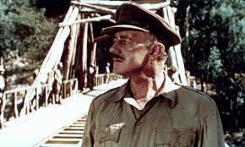
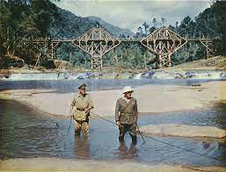
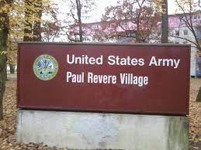
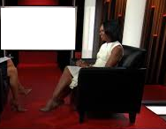
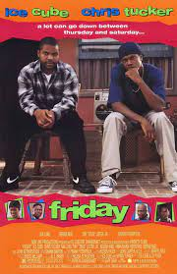


FBI
partner
development
1994
Military
Movies

Slide 10











FBI
partner
development
1994
HOMICDIE:JESUE.IPX(3x).ghoeh(michealback,Unimog)
IPX, HOMICE:JSUE(lutz)
MITLITY Lovelace
IPX
App.touch.greensmpls.chrils.ventrura
LACE
Missed the bus,wiggi wack
Police Sirens: 6:04

Slide 11




FBI
partner
development
Hudson Court
1990 December
japanese super mario 1990
JOHN(Neo Geo): !recyling
Polci Sirences: 5:39PM
c5
J5
Origin: Salem[1] or Sadam 1 is unknown
IMPORTANT: 41.ATOMCLOIC(Soul Aysmolu, runawaytrain with salem/sadam[o]?)
Polcie Sirent 5:44PM

Slide 12








FBI
partner
development
Utility Game?
WEAPON:
41.INT.Ghohe(Tyson)

Slide 13










FBI
partner
development
1987
41.nonPolcieStrekcrimefight.GENENTECH.FACEBOOK
90% 000.tw.pns §AggAssualt, §Assualt
1994-6
1986
1987
1988
1988
1993
!HOMCEI:BILL
MLITIARY.LARRY
1990
Rui
Al kaida
CAMP DAVID
eros
(Bill copy)
1999 G.GOD.ghoeh(dj).delle donna
2001 Univeristy
2003 Job
Polcie Sirnes: 6:43PM

Slide 14





FBI
partner
development
1986/7
PG-+13
Elvira
0.01
Matt Ward
PG-+13
Glu, Matt Ward
Gryp, Cypt, Chinse Food Box
Ghoeh(mike)
Deborgah:
[x]no
i.E §Stalking
PREA.CPVA.MATHEW: captioi Sacrametto
tyson
1988/9 Earthquack Football x/y
41.MATHER:
Whiat and !bhiete
SF(White): HOCMIE:TRANVEST.explaine.MATHEW

Slide 15













FBI
partner
development
1991 January
Incident:
Child Abuse, no food
JFK(painting !origina)
Davis to Los Angelses:
Step: we had to lock refrigerator
41.CPVA
TORT-3
Stanford
Danger Mouse
Genentech
JFK(report to lukanocie).white
Jeff, minon leage college baseball
Swimming
MLK(reprot from KING).!white
Danger Bob
ATOMCLOCI(tim,indoor socker facebook)
ATOMCLOCK(Tim Tiberton, Calbbel, Mathew:wellsfargo, Danger Bob, Bierbash)
Ymca.Pope.Marin.St Anselm: Caleb/Jason
HOMCEI:JEUSE.Achso
POLCIE SIRENETS: 7:12PM
[x] no SQ.apple.greenstampa.touch

Slide 16










FBI
partner
development
kindergarden felton santa cruz
41.Jewish sandwich and cubbie
Polci Sirens: 7:18PM
Sleep on nosie
41.MOHTER: she was moleted
Appel.tango.artarti.grensamps: she was moleted
CPVA.moody finanicalsSF
ATOMCLO.SALES(Jenny ATB.41.tv;
INTERUPTS Omamaha redtruck phil)
montesory naptime black male

Slide 17



FBI
partner
development
1986/7
§Stalking
Motoccylle 7:27pm
IMPRT DEA(crack,sheetrock) !AVAVIALBITY:MATHEW:MAINSTREET.MARKET.DEA(sheerocke).Apple.touch

Slide 18













FBI
partner
development
1986/7
March 23rd, 1987
ryan bmx bicylce 1984
41.asusm.data: brneete front door school !picked up
Sung, Kindergardner
§Theft October 1986 – 1 Day
Korean Race car toy
Polcie Sirens: 40Y
1D8723.Mr magoo
x
Mr magoo
!ms maggoo

Slide 19


FBI
partner
development
1986/7

